Slide 1
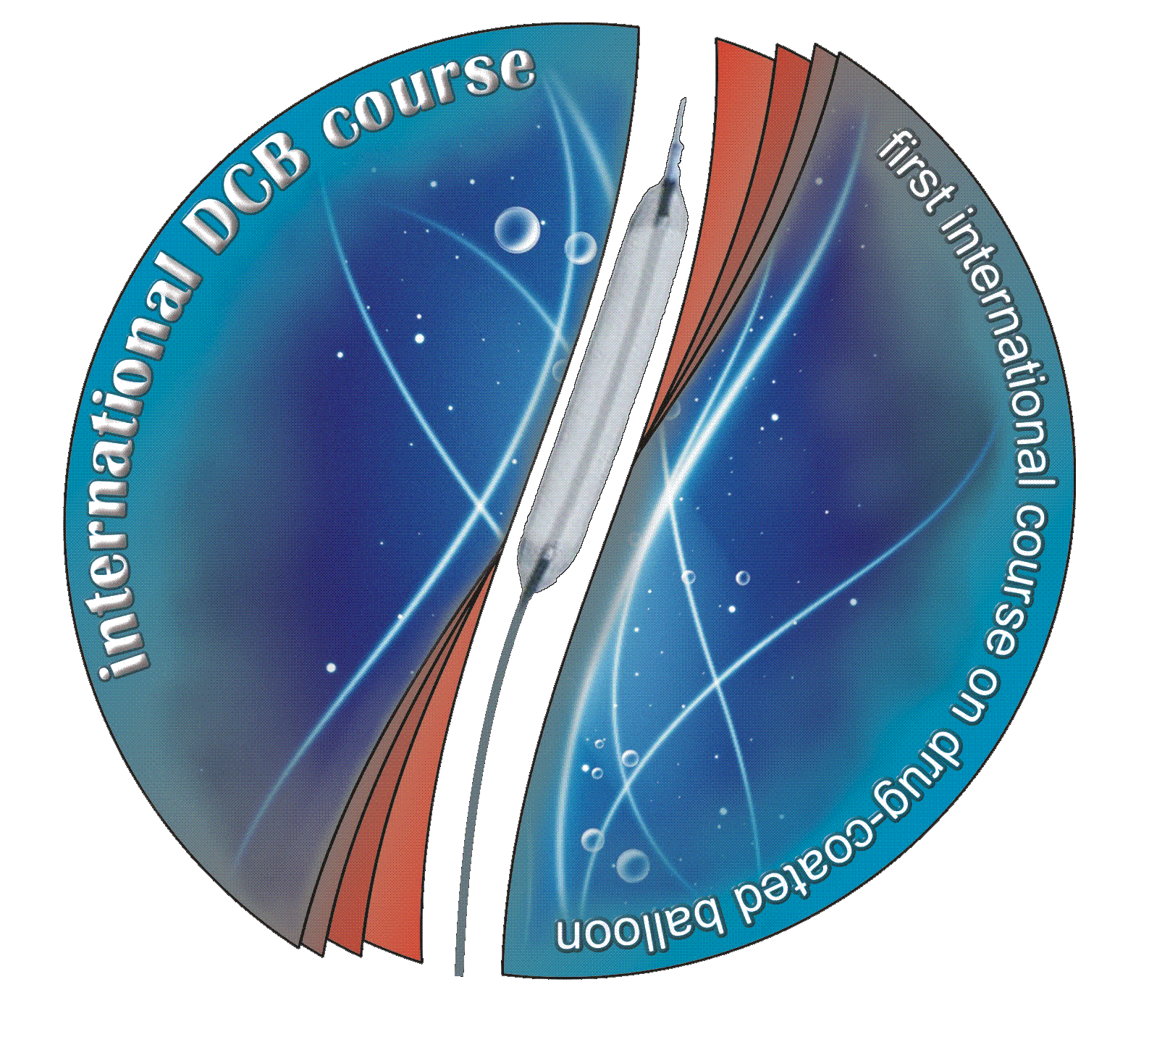
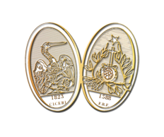
BVS Absorb use in 2014:
an Experts’ survey
Bernardo Cortese & Marco Valgimigli
A.O. Fatebenefratelli & Thoraxcenter
Bernardo Cortese
Intv’ Cardiology, A.O. Fatebenefratelli
bcortese@gmail.com

Slide 2
aims
to “interview” the most qualified experts on this technology aiming at understanding at which stage we are, and where we are going.
Experts:
-first name/corresponding author of at least one publication, or
-documented experience with 20 implantations.

Slide 3
Apr-14
May-14
Jun-14
Jul-14
Aug-14
Sep-14
Oct-14
roll-in
139 Experts: email sent
responses collected
data analysis
solicit
14 countries: Europe, America, Asia

Slide 4
Q1: how many implants of BVS have you performed till now?
Q2: how long have you been using BVS? >2 years; 1-2 years; 6-12 months; <6 months.
Q3: in your personal PCI casuistry, how often do you use a BVS? >50%; 25-50%; 10-25%; 5-10%; <5%.

Slide 5
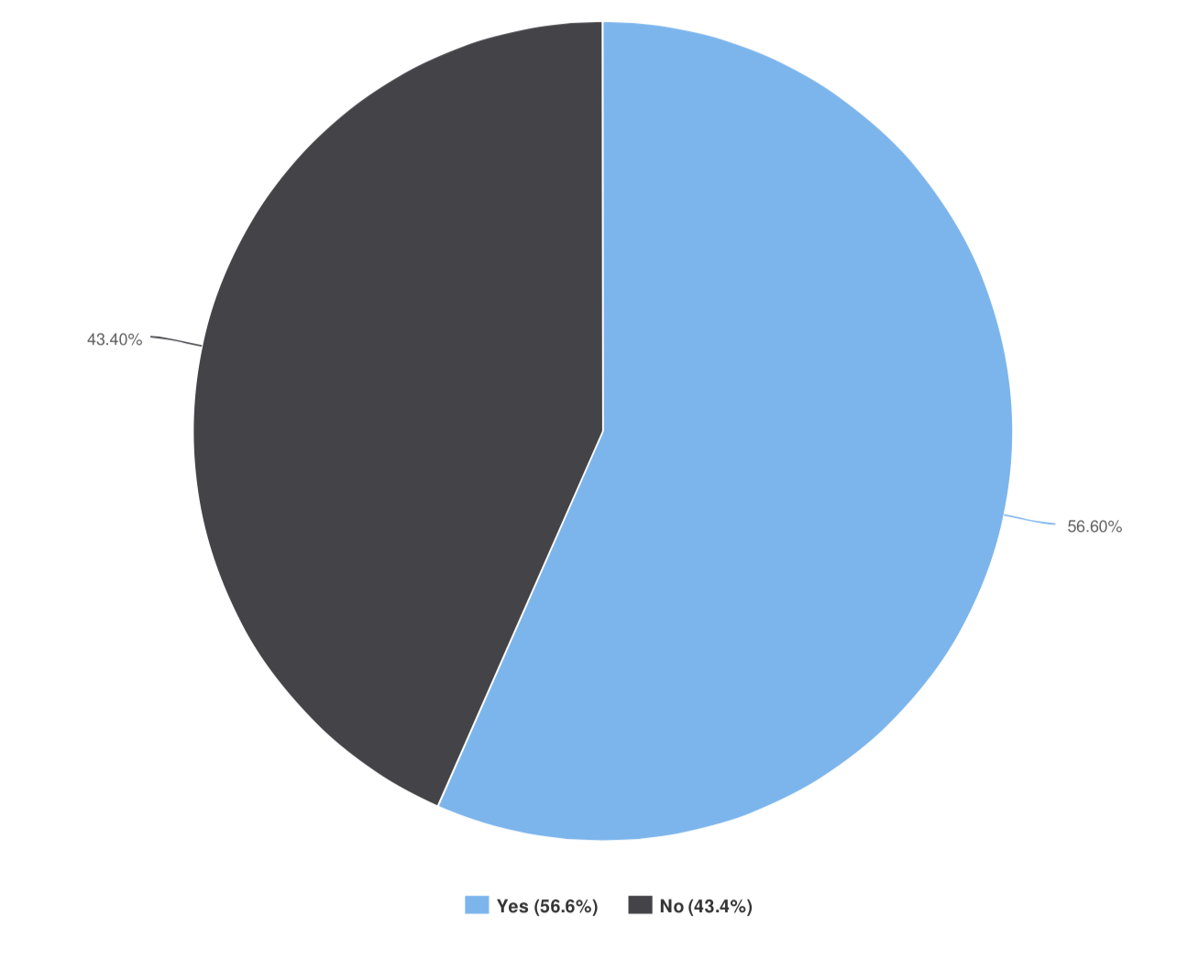
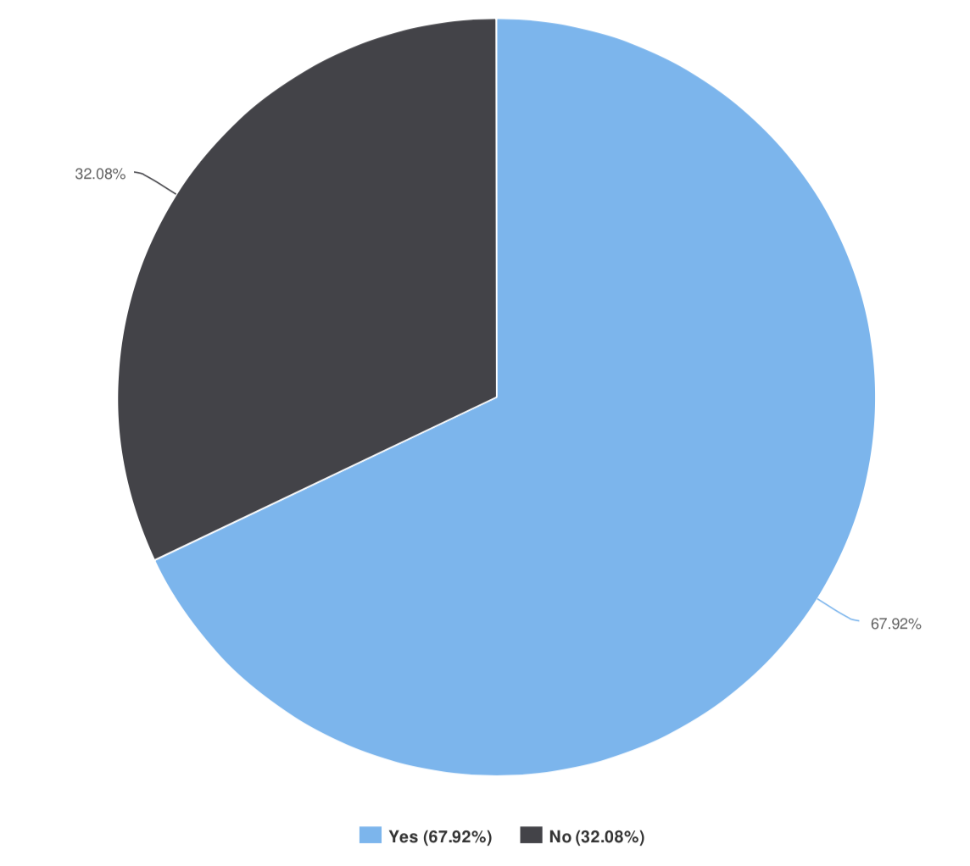
Q 4, 5: do you use BVS in complex settings?
STEMI
B2/C lesion type

Slide 6
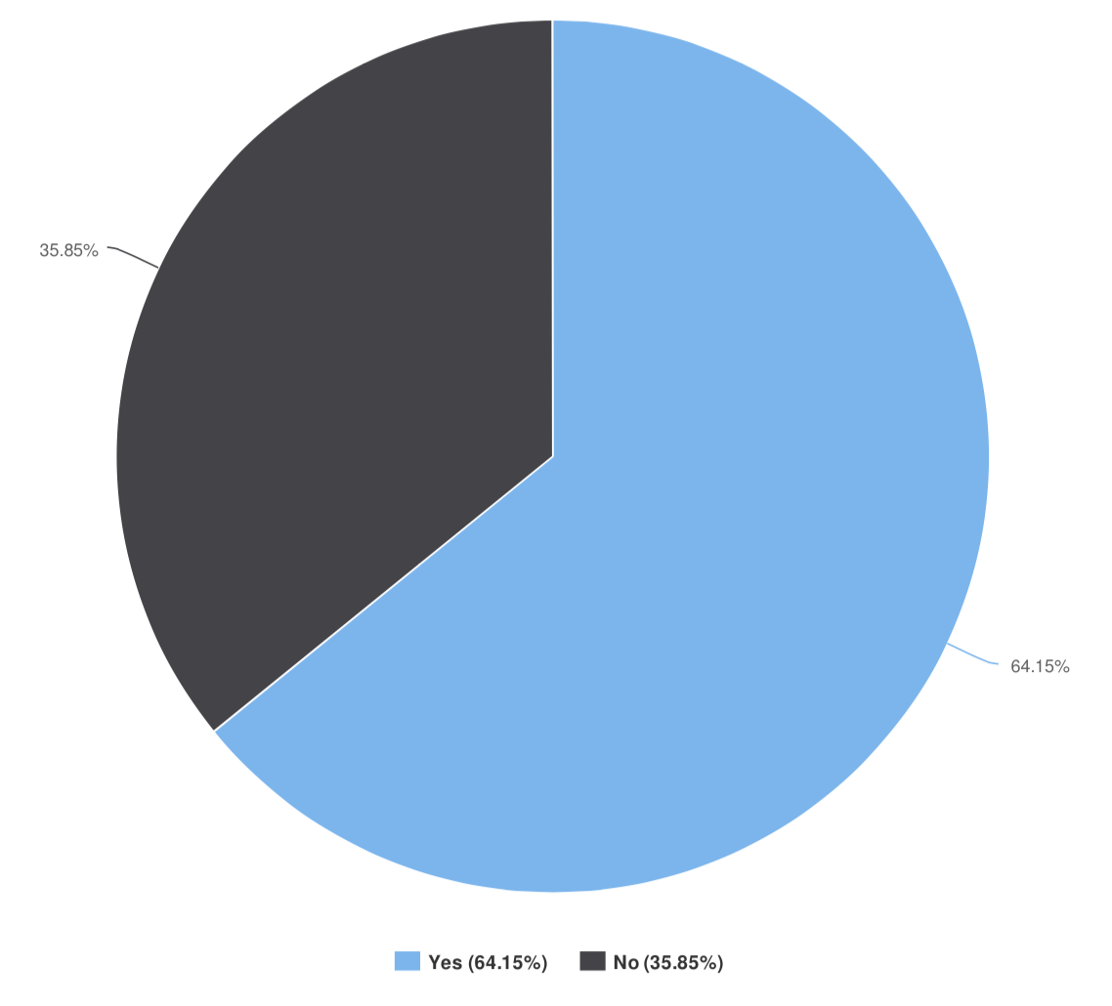
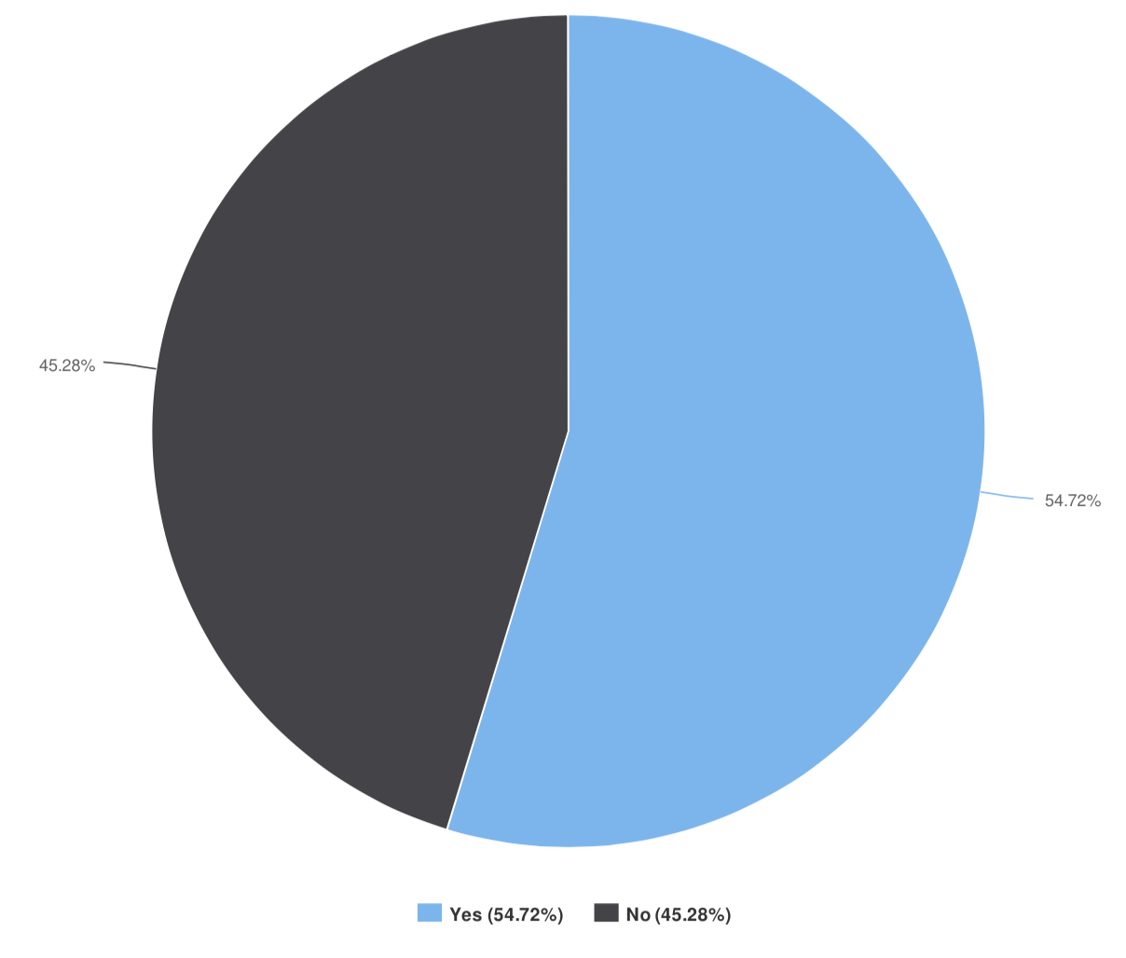
Q 6, 7: do you use BVS in complex settings?
mild/moderate calcifications
bifurcations with >2 mm SB

Slide 7
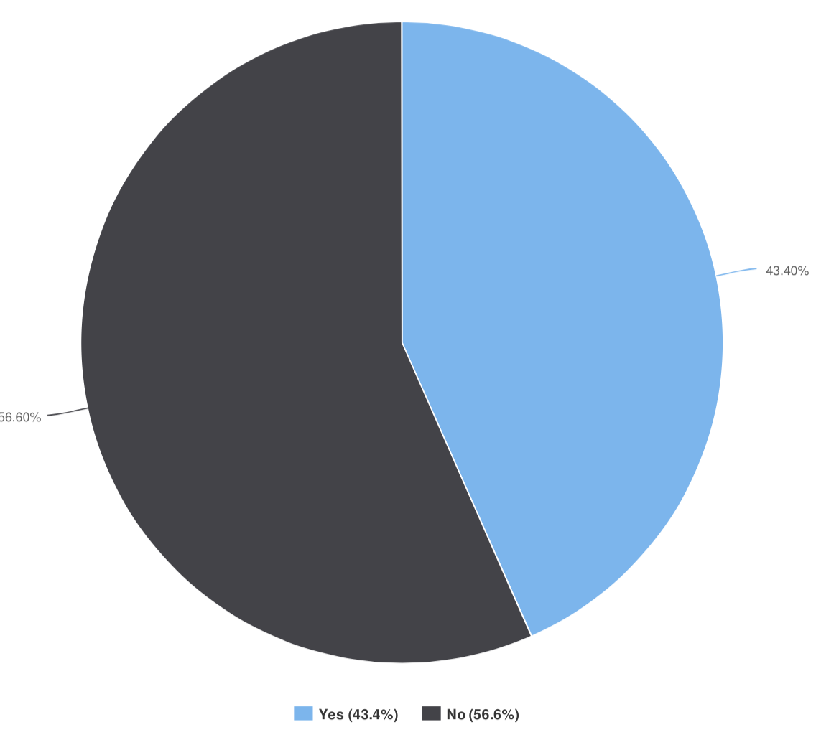
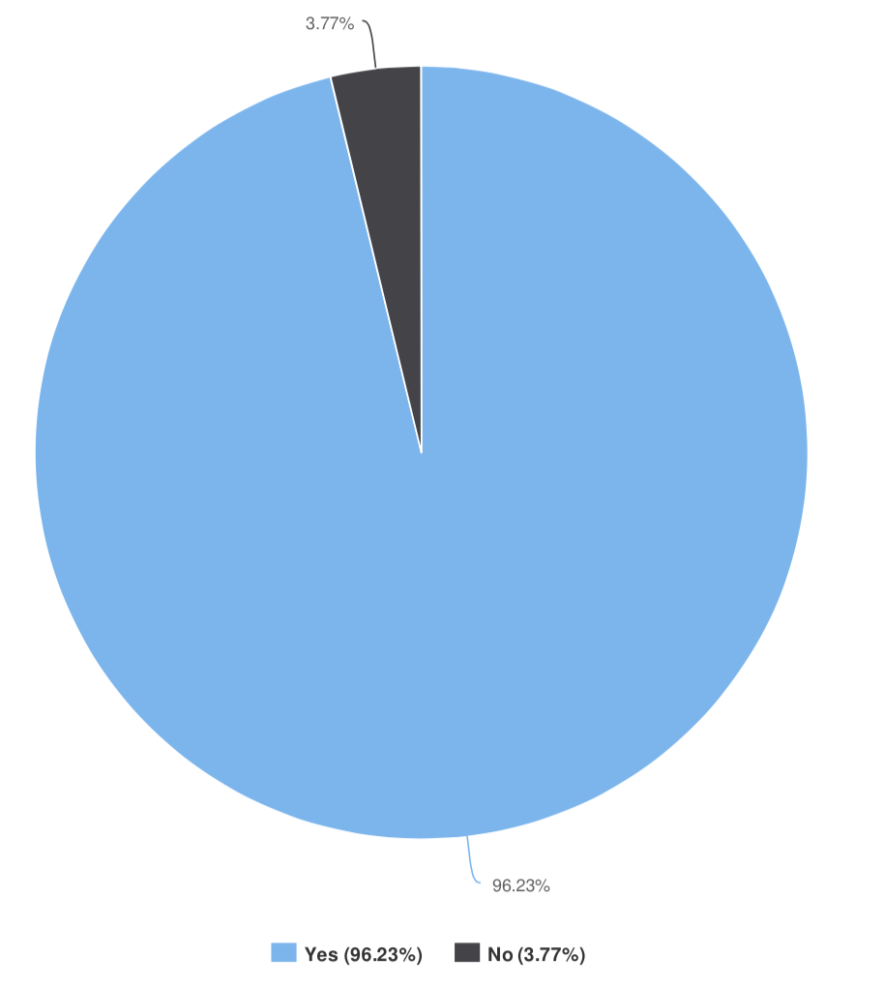
Q 8, 9: do you use BVS in complex settings?
CTO
long lesions >20 mm

Slide 8
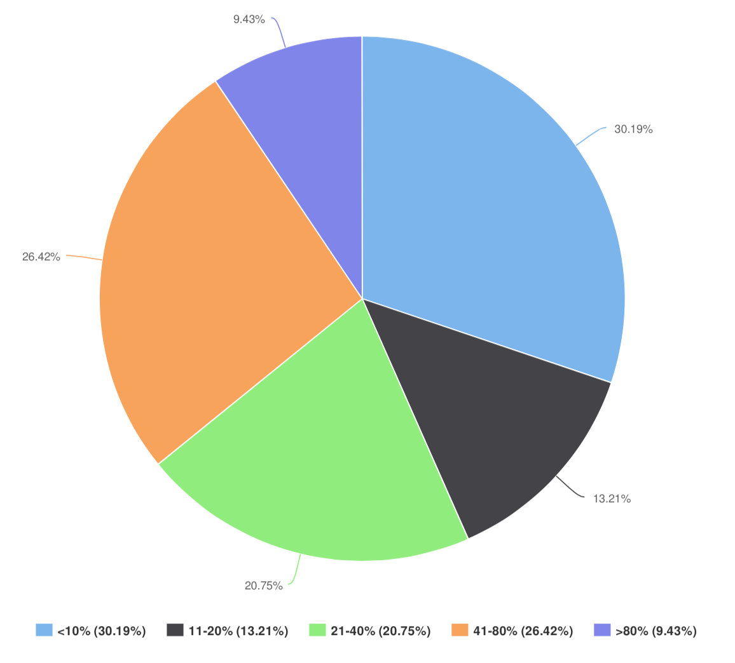
Q10: in what percentage of implantations do you use IVUS/OCT guidance?

Slide 9
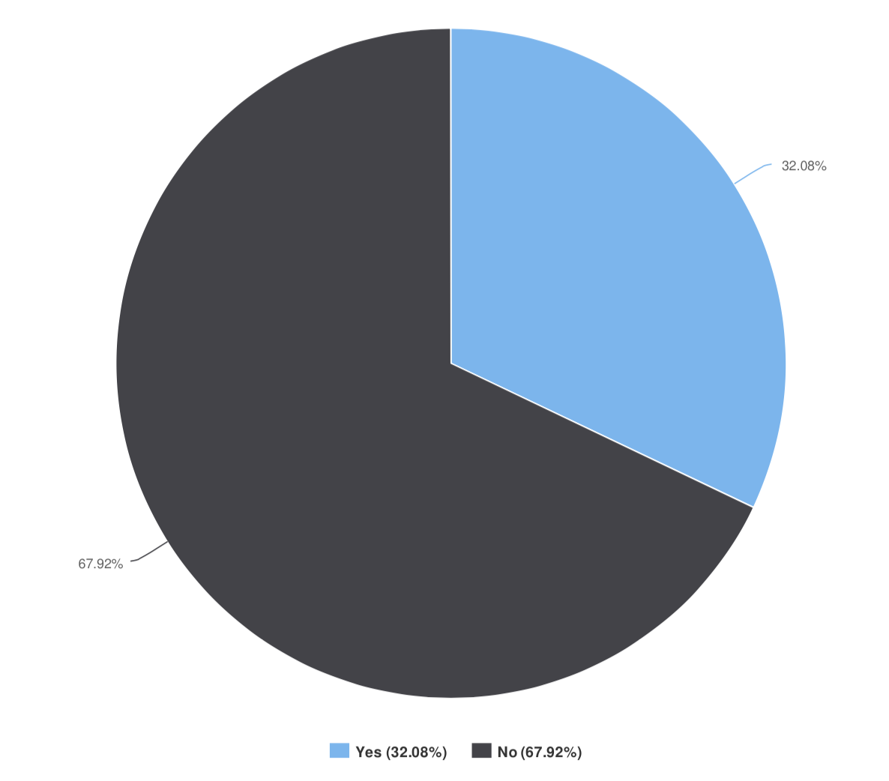
Q11: do you think that acute scaffold recoil is an issue?

Slide 10
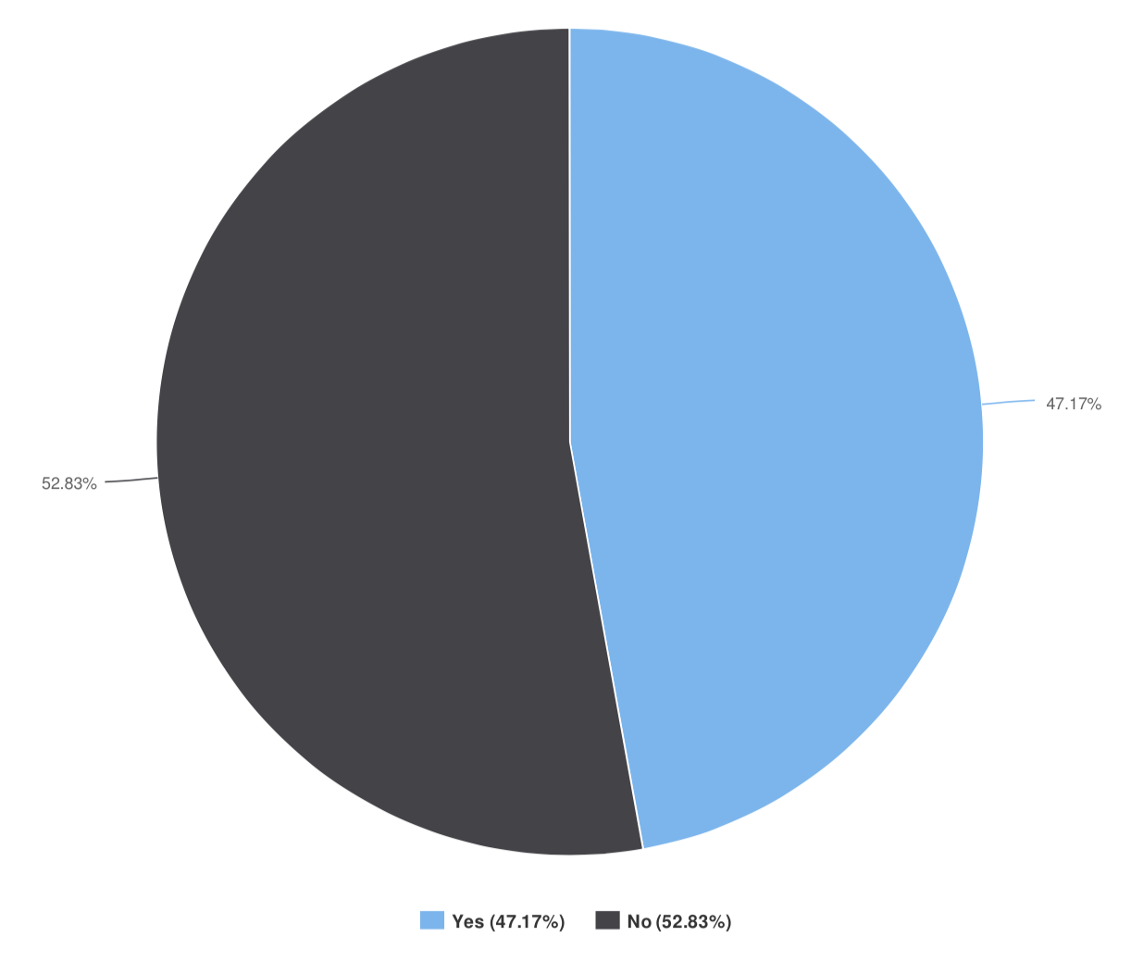
Q12: do you think that scaffold malapposition is an issue?

Slide 11
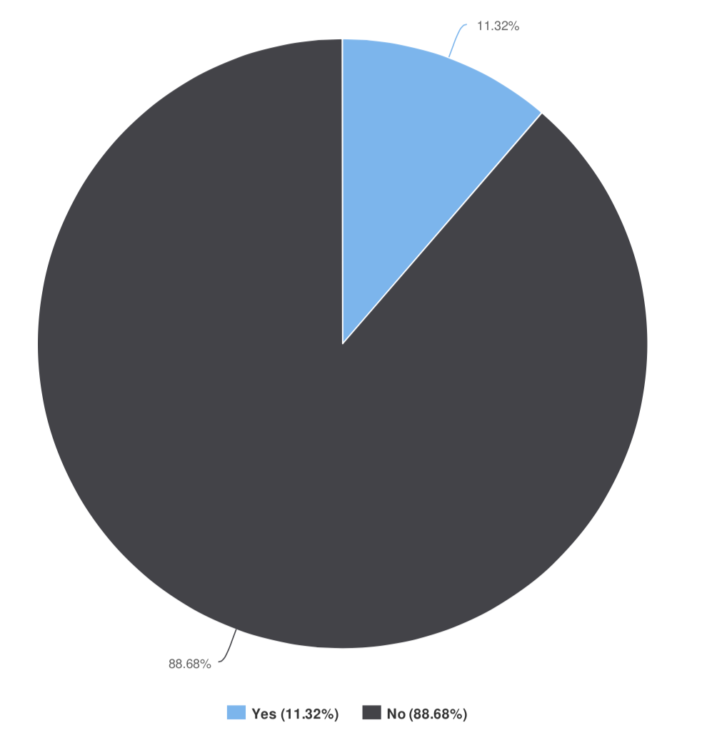
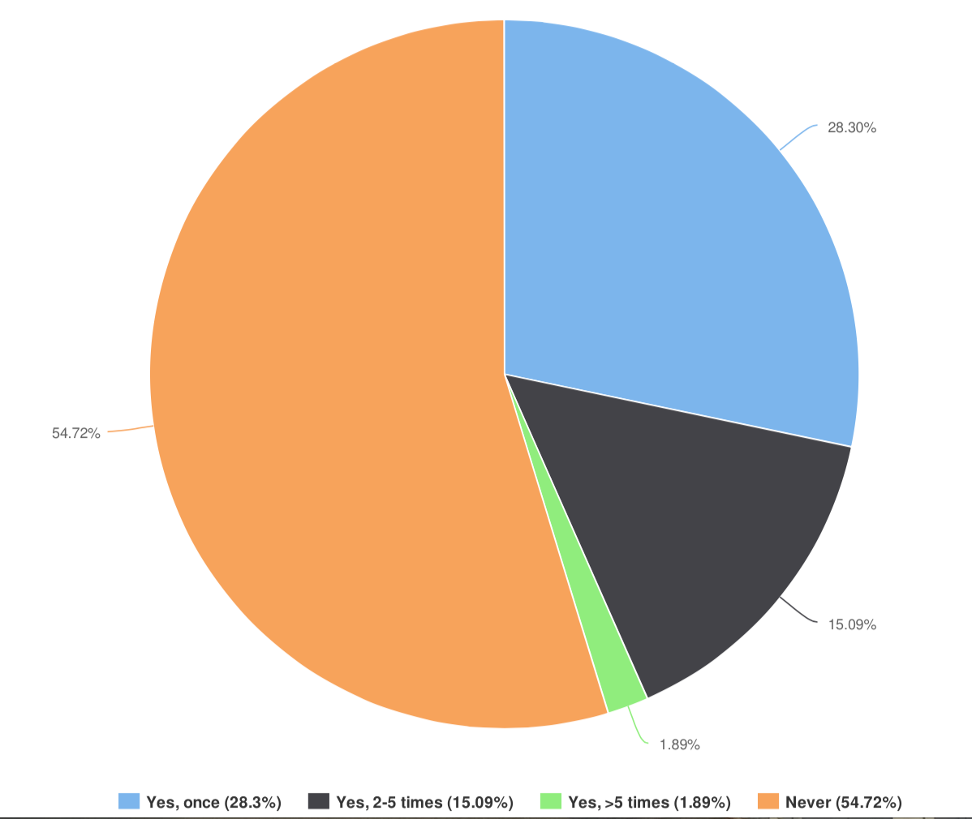
Q 13, 14: have you ever had a patient with scaffold thrombosis?
intraprocedural
early

Slide 12
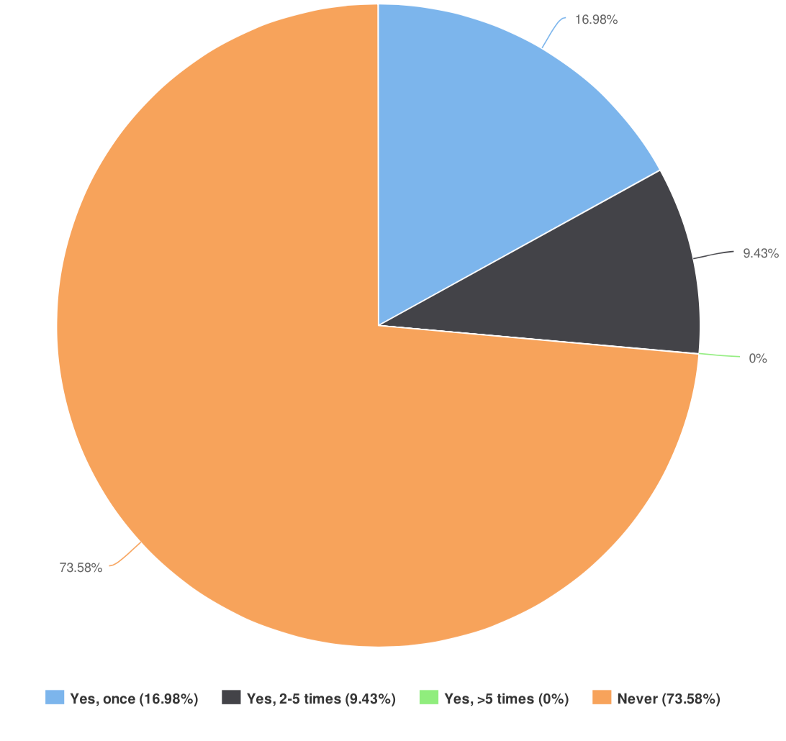
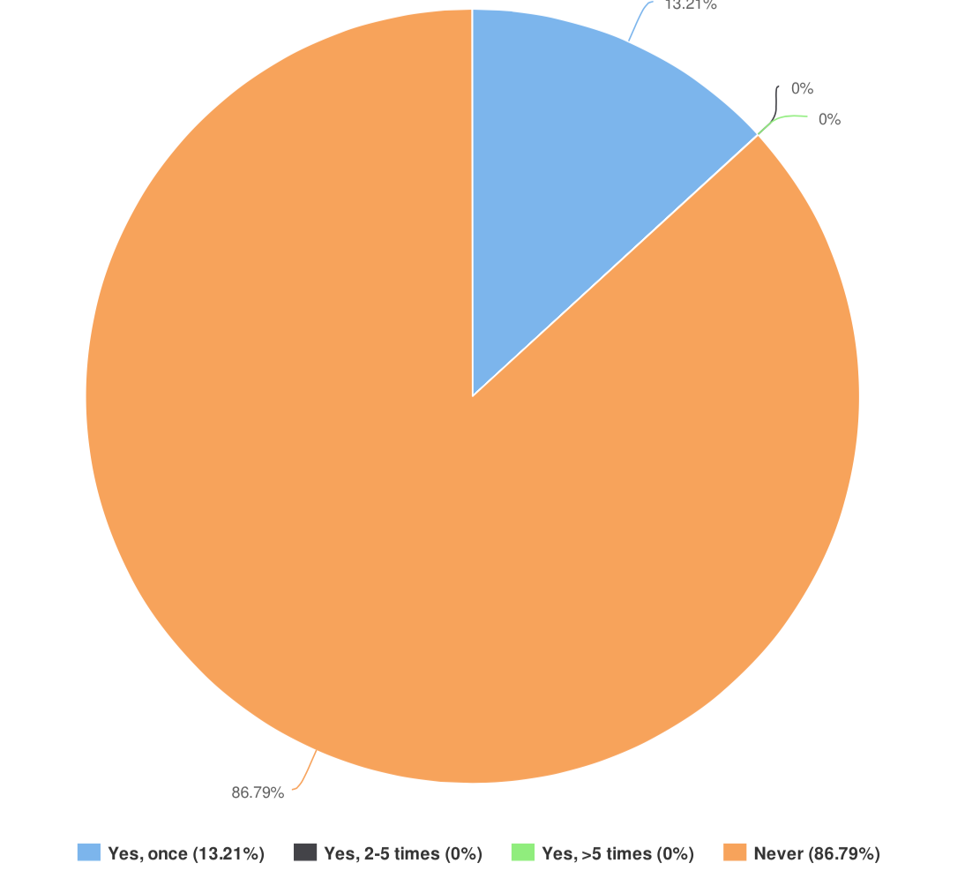
Q 15, 16: have you ever had a patient with scaffold thrombosis?
late
very late

Slide 13
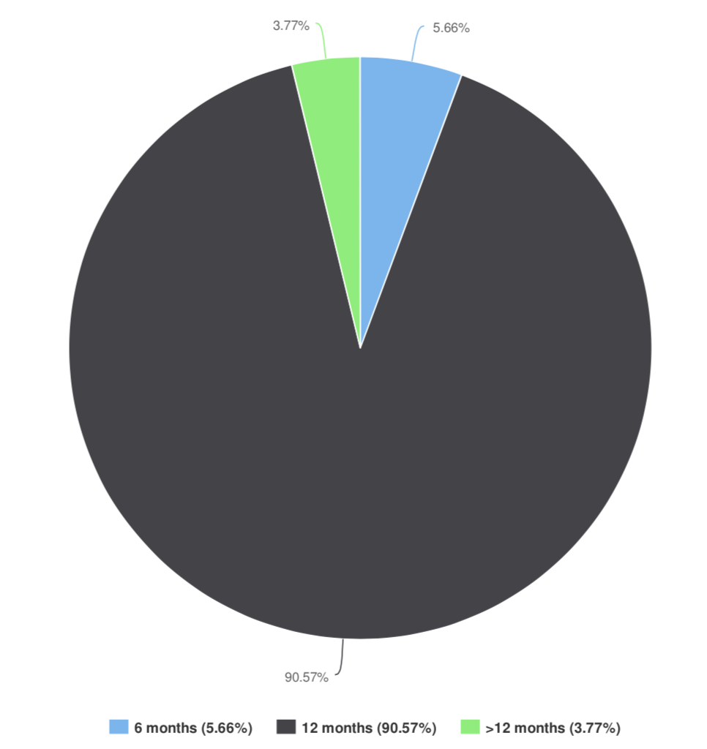
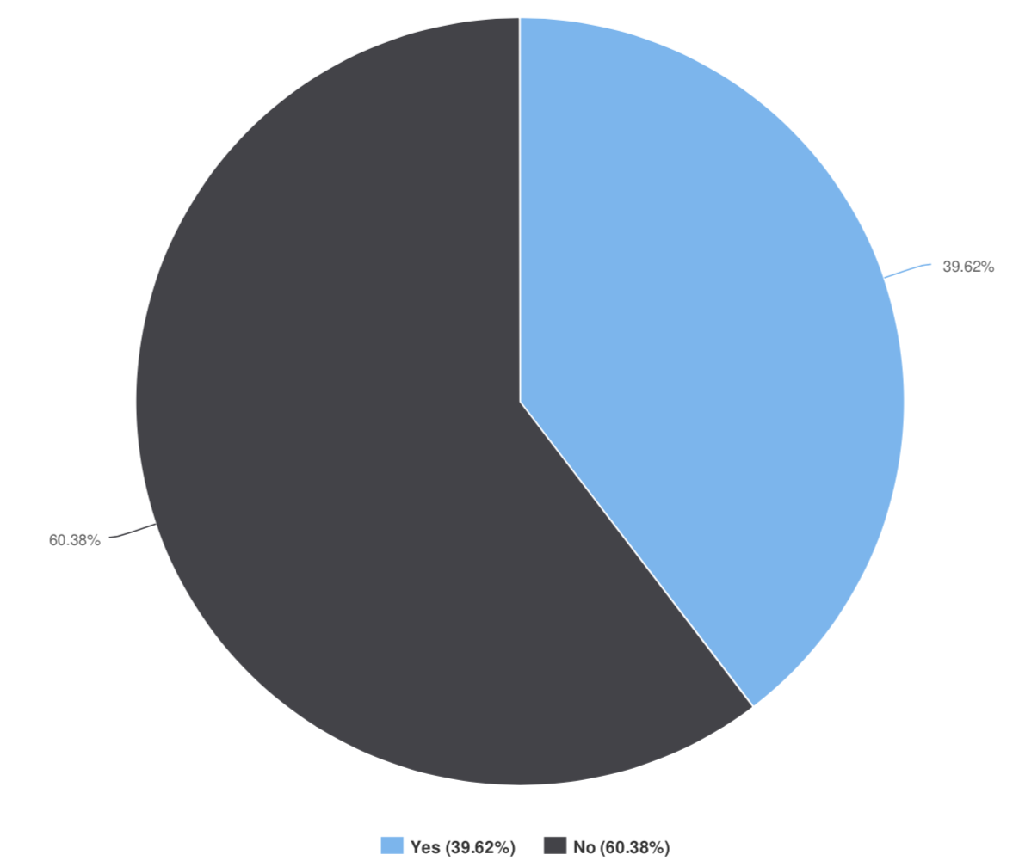
Q 17, 18: DAPT duration
DAPT longer?

Slide 14
BVS Experts’ survey
Real-world data are needful to understand new technologies
BVS implantation is a “delicate intervention” that deserves more time than normal DES-PCI
Experts’ perception is that the issues (like ST) that should be better addressed around this tech are relative to the first month and may be related to the implantation.

