Slide 1
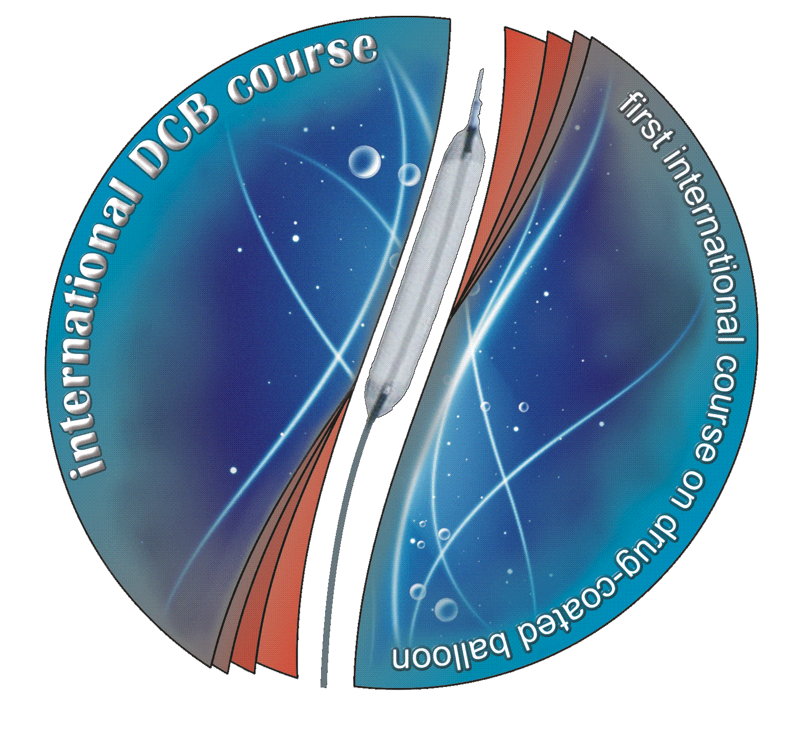
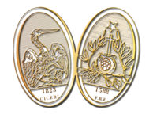
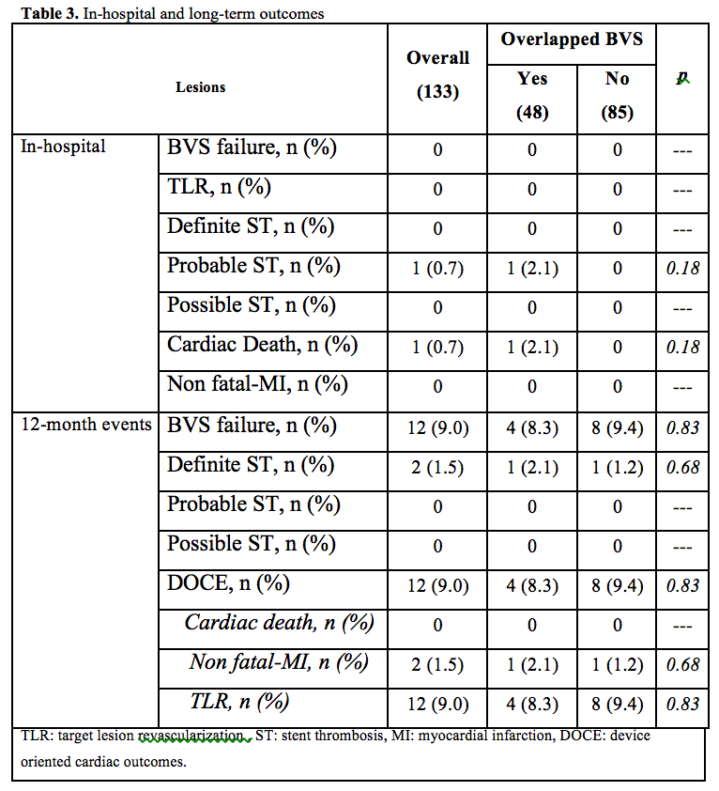
The BVS-SAVE Italian registry:
Bioresorbable Vascular Scaffolds
for the Treatment of Small Vessel Disease
RA Latini, F Granata, A Ielasi,, E Moscarella, M Tespili, PS Orrego, A Varricchio, B Cortese
A.O. Fatebenefratelli, Milano; Ospedale di Nola; A.O. Bolognini, Seriate
Italy
Background: management of small coronary vessel disease with percutaneous coronary interventions (PCI) is often associated with high recurrencies and an increased risk of late or very late adverse events, including stent thrombosis . Currently, little is known about bioresorbable vascular scaffold (BVS) behavior in this setting.
Methods: a retrospective cohort analysis was performed in consecutive patients treated with BVS implantation in vessels whose diameter was <2.8 mm at 3 high volume italian centers with a certificated experience of >3 years of BVS implantation. Primary end-point was the occurrence of BVS failure (any event between of target lesion revascularization –TLR- and BVS definite thrombosis) at the longest available follow up. Secondary end-points were device-oriented clinical outcome (DOCE, defined as a composite of cardiac death, non fatal myocardial infarction and TLR) or its single determinates at 12-month follow-up.
Results: a total of 121 patients (133 lesions) were treated between March 2013-December 2014. From baseline clinical and angiographic characteristics emerges a highly complex patient population. Procedural success was obtained in 132 (99.2%) cases. In-hospital events included one perforation sealed with covered stent and one cardiac death due to probable scaffold thrombosis. At the longest available clinical follow up (average 12±6 months), 70% of patients were still on dual antiplatelet treatment. Primary end-point occurred in twelve patients (9,0%), including twelve (9.0%) TLR and two (1.5%) scaffold thrombosis. DOCE occurred in 9.0% of cases. The use
of overlapping BVS in this setting did not increase the risk of any event.
CONCLUSIONS: to the best of our knowledge, this is the largest registry of small coronary vessels treated with BVS. In this cohort of consecutive complex patients, BVS implantation was technically feasible and effective in maintaining vessel patency after 12 months.

