Slide 1
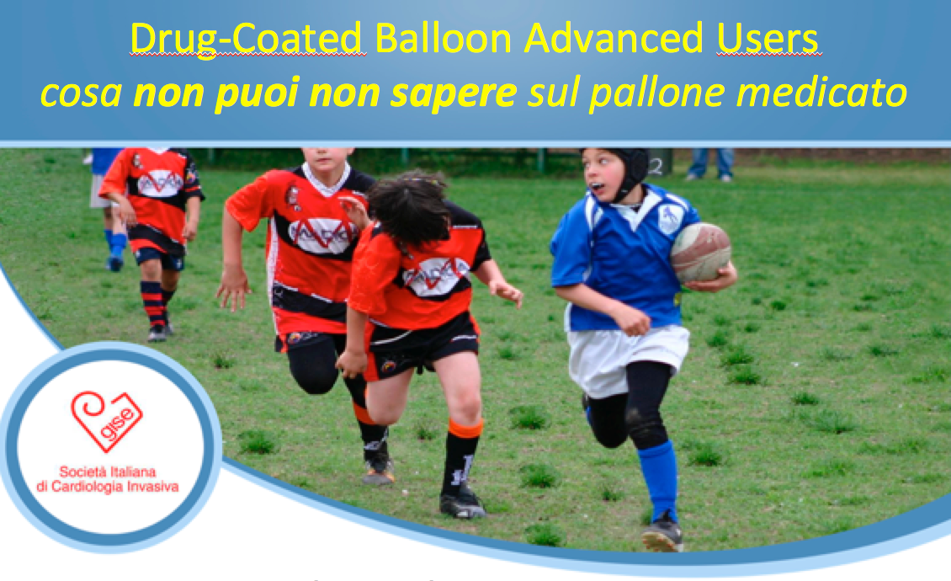
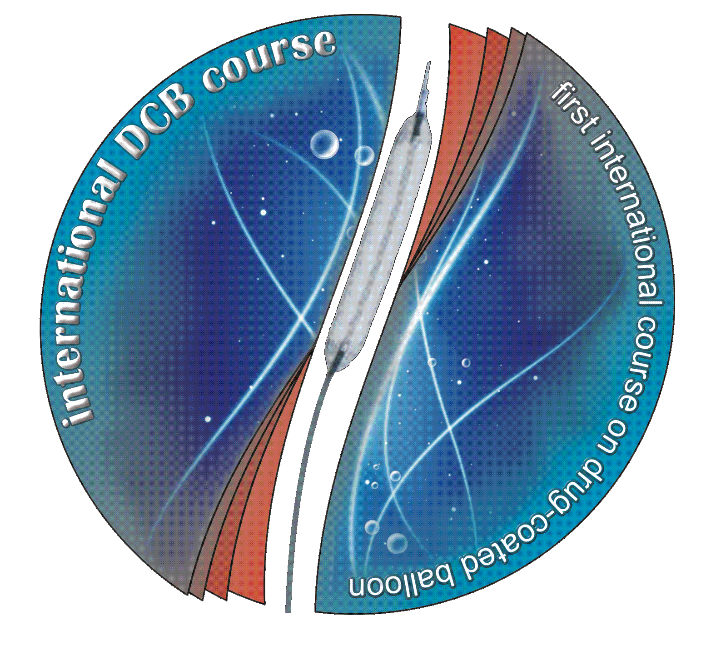
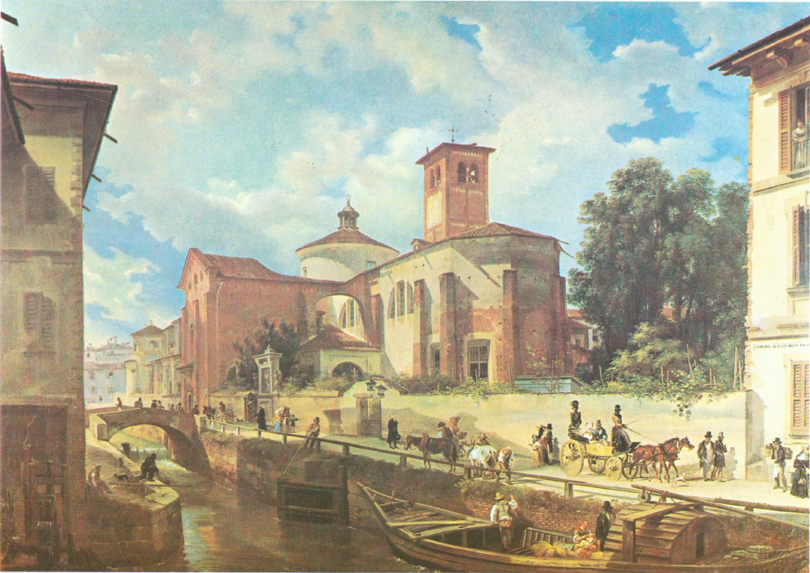
The new consensus document on peripheral DCB PTA
B. Cortese, J Granada, B Scheller, PA Schneider, G Tepe, D Scheinert, L Garcia, E Stabile, F Alfonso, G Ansel, T Zeller
Bernardo Cortese
Intv’ Cardiology, A.O. Fatebenefratelli
bcortese@gmail.com
bernardocortese.com

Slide 2
Disclosure Statement of Financial Interest
Within the past 12 months, I or my spouse have had a financial interest/arrangement or affiliation with the organizations listed below.
Affiliation/Financial Relationship
Company
Grant/Research Support
Consulting Fees/Honoraria
Movi, AB Medica, Medtronic
Cardionovum, Abbott Vascular, Concept Medicals, Acilia, The Medicines Company

Slide 3
DCB consensus documents (coronary field)
German Drug-eluting Balloon Consensus Group
(Kleber FX, Mathey DG, Rittger H, Scheller B) Euroint 2011
German Drug-eluting Balloon Consensus Group, II edition 2013
Drug-Coated Balloon Treatment of Coronary Artery Disease: A Position Paper of the Italian Society of Interv. Cardiology
(B Cortese, S Berti, G Biondi et al.) Cath Cardiovasc Int 2013

Slide 4
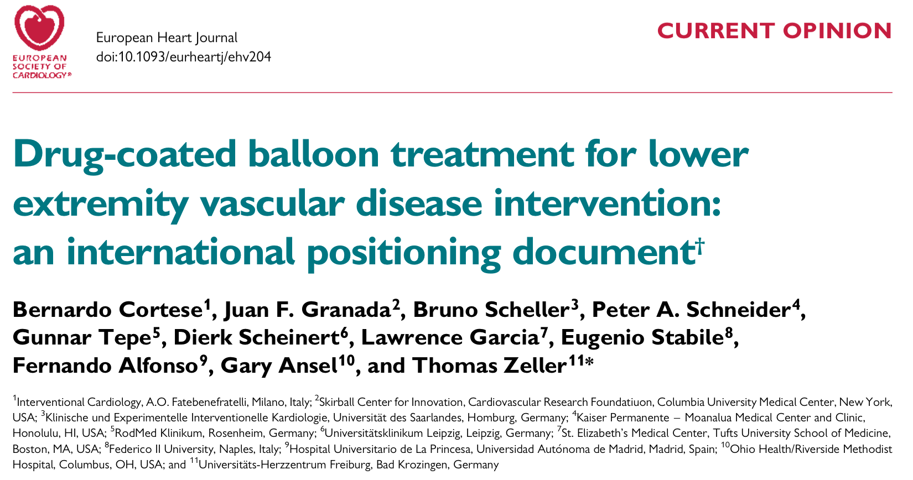
Steering Committee:
B Scheller, J Granada, T Zeller, B Cortese

Slide 5
Background
DCB have robust bench and preclinical data (peripheral and coronary)
Clinical data for peripheral intv’s is not robust and regards only a few available devices
Currently, scientific societies’ guidelines on DCB use in the peripheral field are not available

Slide 6
Reasons for a Consensus Document
To provide a comprehensive framework to guide clinical practice and to discuss challenges and future perspectives in territories where a gold standard treatment is currently not available and current treatments are of limited efficacy.

Slide 7
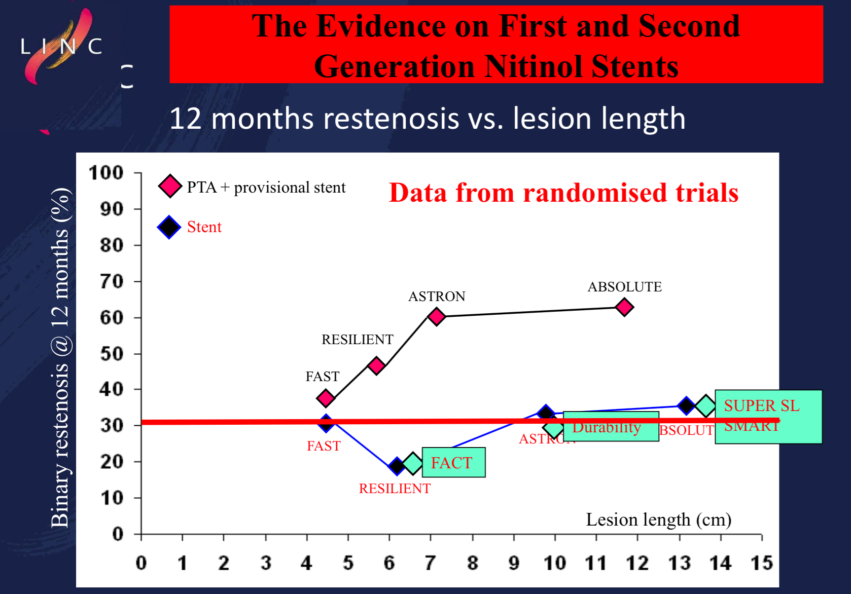
G Biamino, LINC 2013

Slide 8
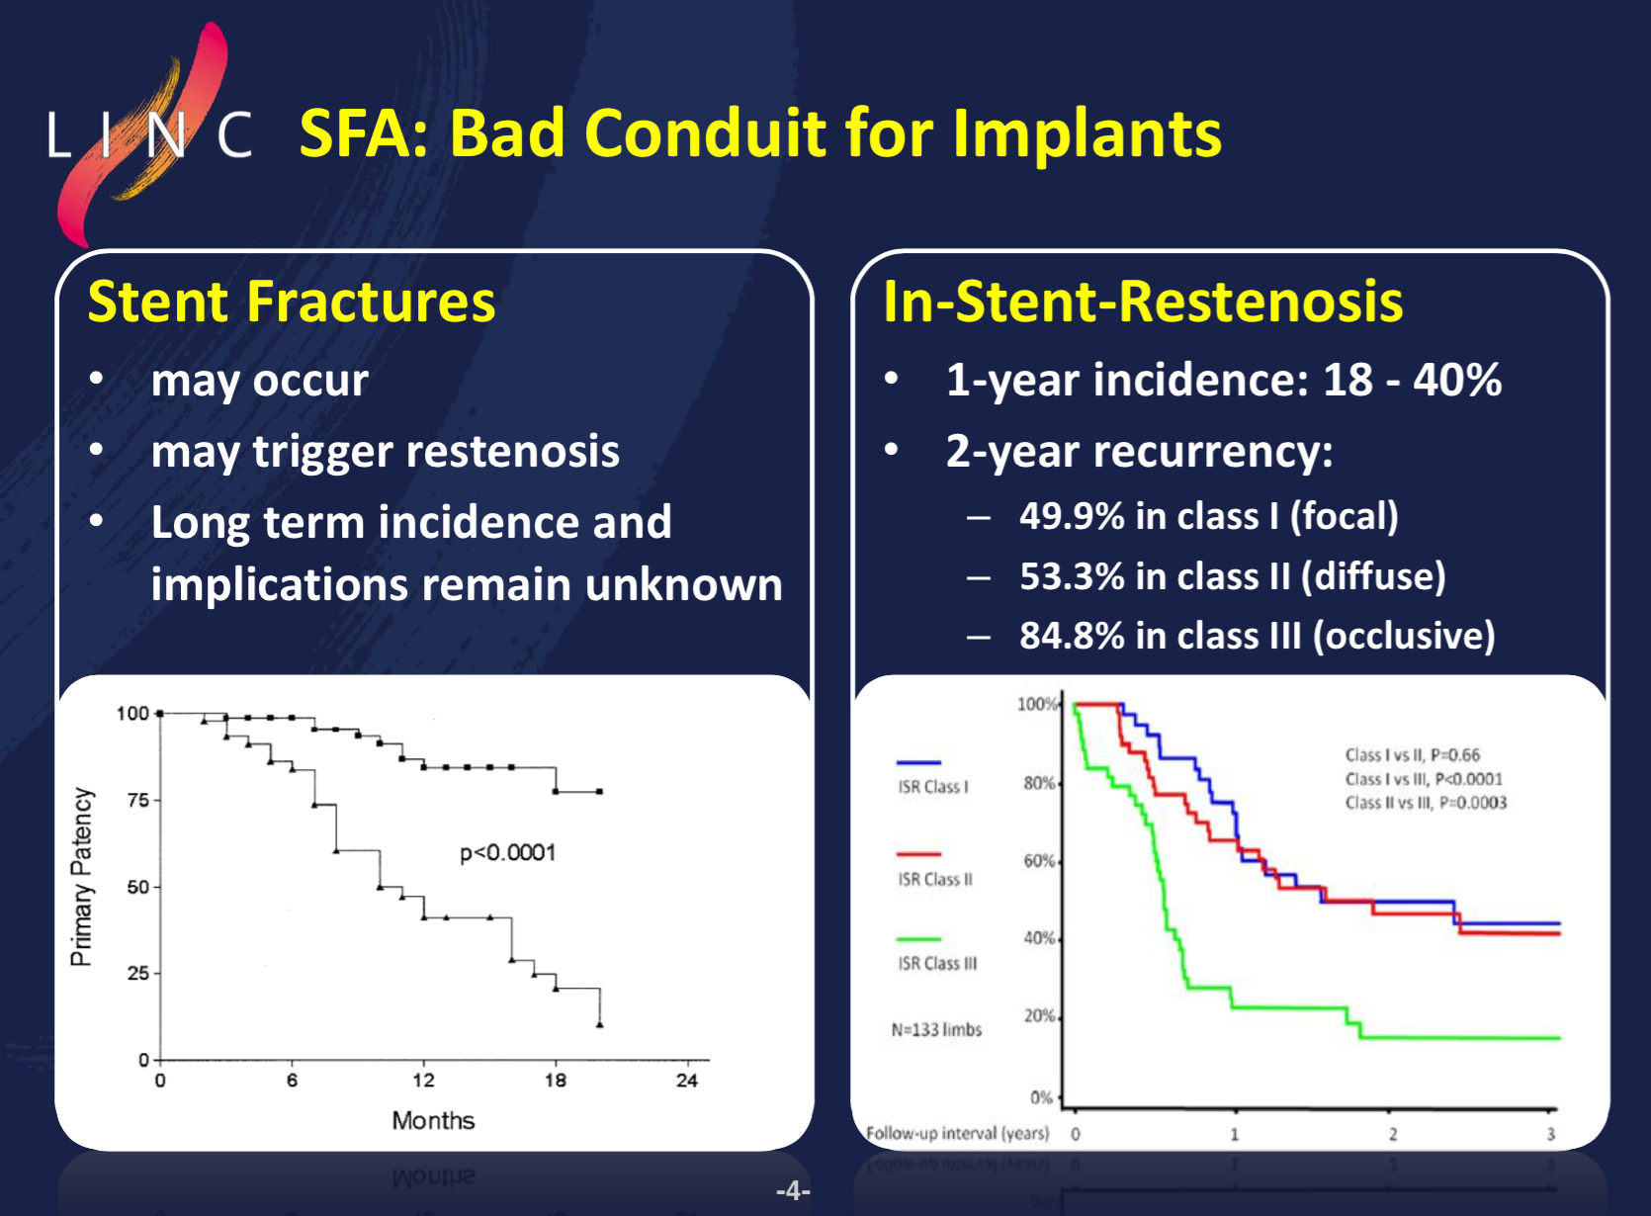
G Biamino, LINC 2013

Slide 9
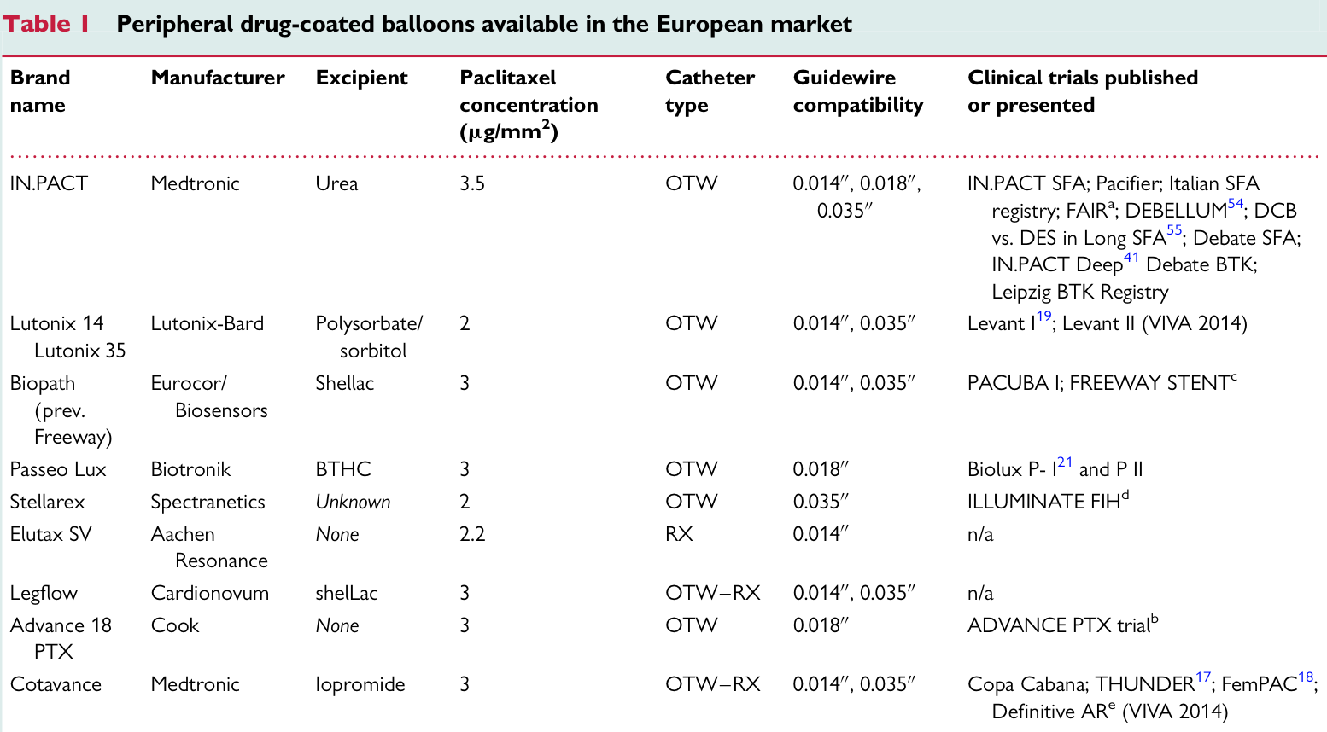

Slide 10
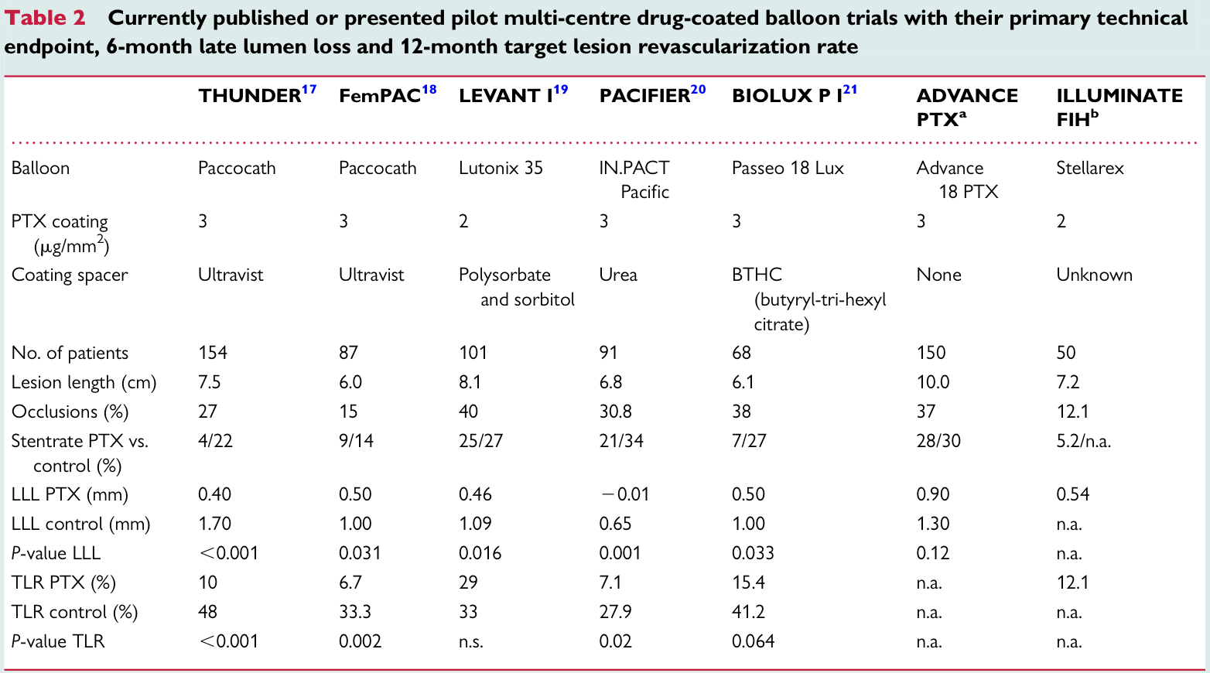

Slide 11
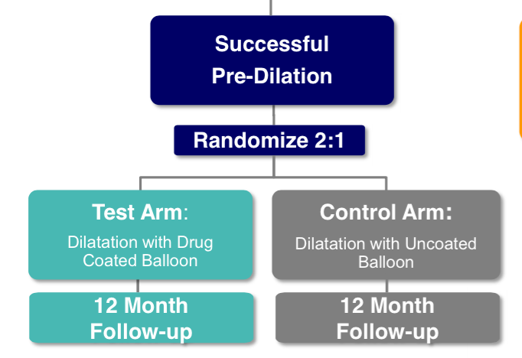
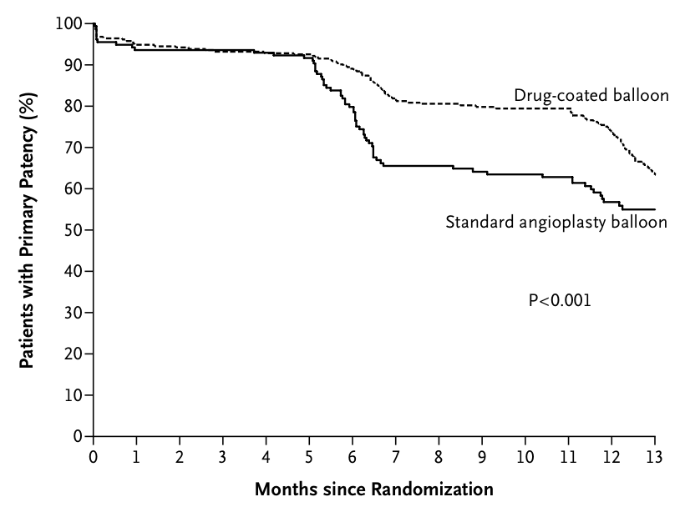
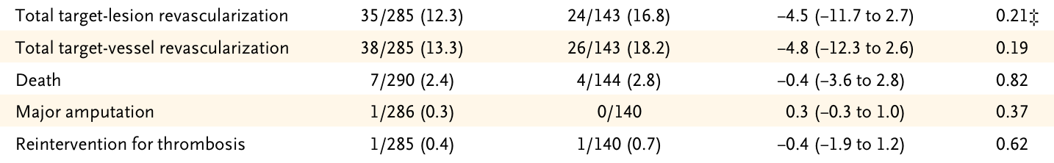
LEVANT 2 blinded follow up
K Rosenfield, NEJM 2015

Slide 12
DCB may heal dissections...
LLL
(p=0.001)
perc diam stenosis
2-Y TLR
20%
56%
56%
10%
...without loosing their antirestenotic effect.
Tepe G., J Endovasc Ther 2013

Slide 13
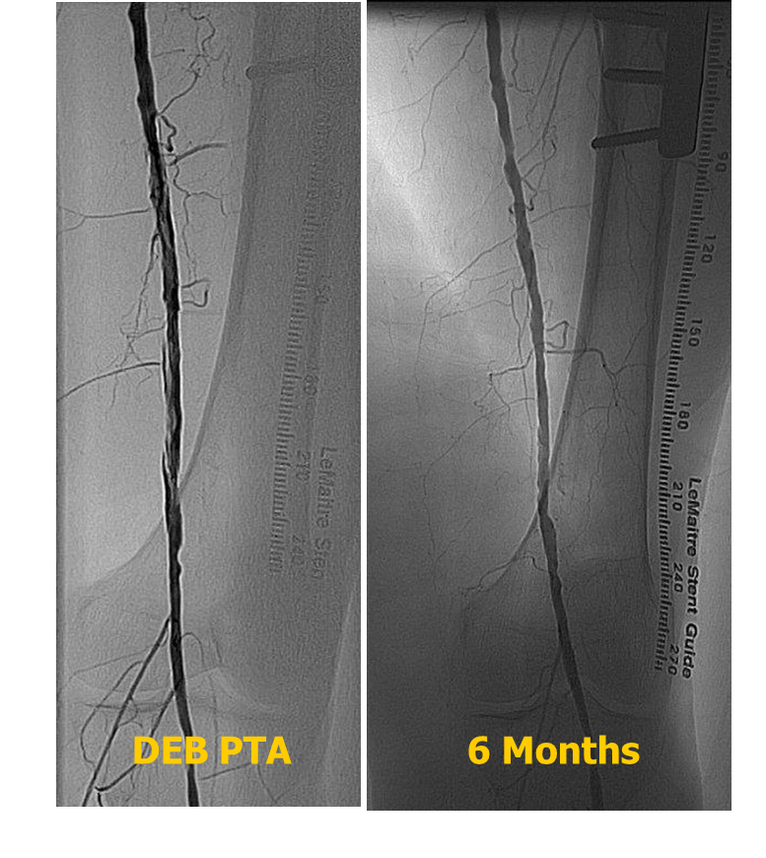
B Cortese ‘14

Slide 14
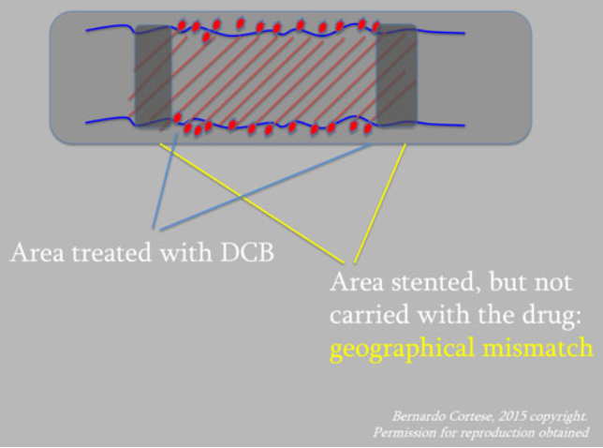
Fem-pop technical considerations
Balloon insertion/navigation
Predilatation
Coverage of the entire lesion with DCB (healthy-to-healty)
Geographical mismatch.
ballooned

Slide 15
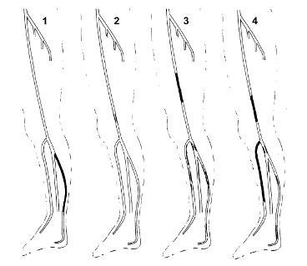
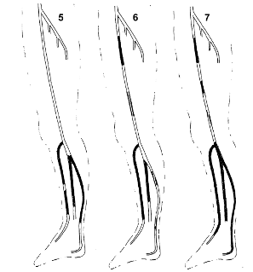
CLI and Diabetes: disease extension and distribution
Predominance of BTK lesions (74% of all lower limb lesions)
Prevalence of diffuse disease with long stenosis and occlusions (66% occlusions, 50% occlusions >10 cm)
BTK: 74% of 2893 lesions from
417 consecutive CLI diabetic subjects
with ischemic foot ulcer
1%
8%
14%
36%
11%
27%
1%
Graziani et al. Vascular Involvement in Diabetic Subjects with Ischemic Foot Ulcer: a New Morphologic Categorization of Disease Severity Eur J Vasc Endovasc Surg 33, 453 460 (2007)
Notes:
CLI predominanltly manifet with a massive multivessel disease in infrapopliteal arteries (74%) and very long lesions and occlusions. 66% of occlusions, 50% longer then 10 cm).
Focal lesions of 20-30 cm consitute a nitche as only observed in selected populations

Slide 16

AMS av. LL 11 mm
Rutherford 5,6
Author/trial/journal | year | device | lesion length (mm) | number of devices used | lesion number | CLI (%) | Ruth 5 (%)
Peeters | 2005 | AMS | 11 | 20 | 20 | 100 | 55
Boisiers AMS Insight Cardiov Interv Radiol | 2008 | AMS/POBA | 10.6/12 | ? | 74/75 | 100 | 73
Boisiers DESTINY J Vasc Surg | 2012 | EES/BMS | 15.9 +/-10.2 vs 18.9+/-10 | 86/92 | 78/76 | 100 | 50
Karnabatidis J Endov Th | 2011 | EES/POBA+/-BMS | 77+/-70 vs 77+/+67 | 332/86 | 102/72 | 100 | 42
Commeau CCI | 2006 | SES | 27.6 (stent) | 62 | 106 | 87 | 33
Balzer J Cardiov Surg | 2010 | SES | 46+/-22 | 341 | 320 | 100 | 46
Rastan EHJ | 2011 | SES/BMS | 31+/-9 | 120/116 | 161 | 47 | 41
Scheinert Euroint | 2006 | SES/BMS | <33 mm | 30/30 | 60 | 63 | 37
Siablis J Endov Th | 2007 | SES/BMS | 14/13 | ? | 66/65 | 100 | 28
Werner J Endov Th | 2012 | SES | 33.6+/-14.6 | 201 | ? | 43 | 32
Scheinert ACHILLES JACC | 2012 | SES/POBA | 26.9+/20.9 vs 26.8+/-21.3 | 410 | 113/115 | mandata email a Scheinert
Feiring PARADISE JACC | 2010 | DES | 26.9+/-5.8 (stent) | 228 | 118 | 100 | 61 (31 Class 6)
Grant CCI | 2008 | DES | 24.8+/-10.9 | 17 | 12 | 50 | 50
Rosales CCI | 2008 | DES | 23 | 41 | 28 | 100 | 50
Cioppa ? | 2008 | BMS | 72.2+/-11.7 | 23 | 20 | 95 | 50
Feiring JACC | 2004 | BMS | ? | 197 | 86 | 68 | ?
Deloose Euroint | 2009 | BMS | 52.2 | 50 | 56 | 100 | 16
Donas Eur J CV Surg | 2009 | BMS | 65+/-9 | 38 | 34 | 100 | 56
Rocha-Singh XCELL trial Viva 1 | 2010 | BMS | 47+/-42 | ? | 140 | 100 | 82
Krankenberg CCI | 2000-(05) | POBA | ? | N/A | 181 | 0 | 0
Schmidt JACC | 2011 | DEB | 173/183 | 113 (?) | 113 | 82 | 64
Liistro DEBATE BTK TCT | 2012 | DEB/POBA | 128+/-83 vs 130+/-79 | ? | 80/78 | 100 | ?
DES av. LL 38 mm
Cortese CRT ‘13, unpublished data
DEB av. LL 238 mm!!!

Slide 17

Limitation of DES placement in long BTK-Lesions
Balloon-angioplasty
Residual stenosis
Focal stenting with DES
Follow-up
courtesy of T. Zeller, 2015
Notes:
They performed spot-stenting with DES. The problem then can be, if treatment are is much longer than the stented are, that restenosis will occur proximal and distal to the stent. Therefore we think DES do only make sense if full lesion covereage is performed.

Slide 18
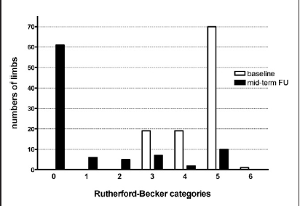
BTK First study (FreePAC tech)
BTK
104 consecutive pts with CLI or IC (17.4%)
binary rest after 3 months: 27%
clinical improvement 1-y: 91%
complete wound healing 1-y: 74%
Restenosis typically focal
Schmidt et al, JACC 11

Slide 19
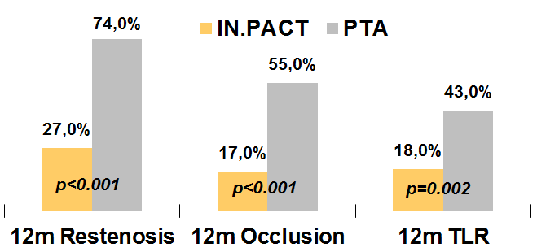
DEBATE BTK (FreePAC tech.)
BTK
vs. POBA
CLI + Diabetes
150 (Tibial) Lesions
random (1:1)
DEB
(75 lesions)
Std PTA
(75 lesions)
Aspirin + Clopidogrel (1 month)
12-month Angiographic
and Clinical follow-up
24-month Duplex
and Clinical follow-up
Liistro et al., JACC 2014

Slide 20
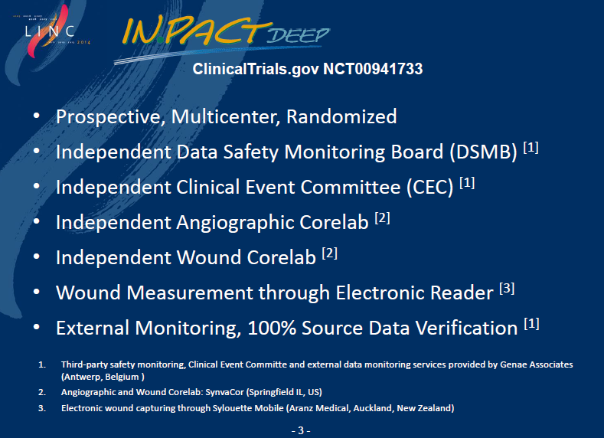
IN.PACT DEEP (FreePAC tech.)

Slide 21
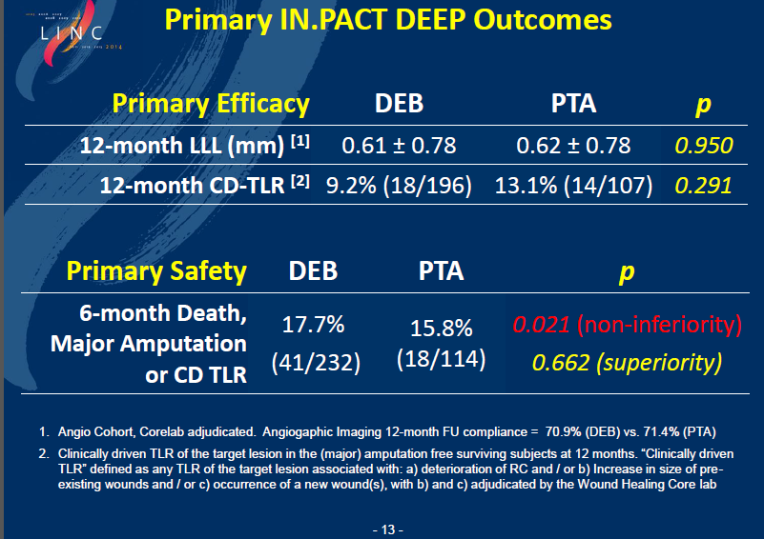
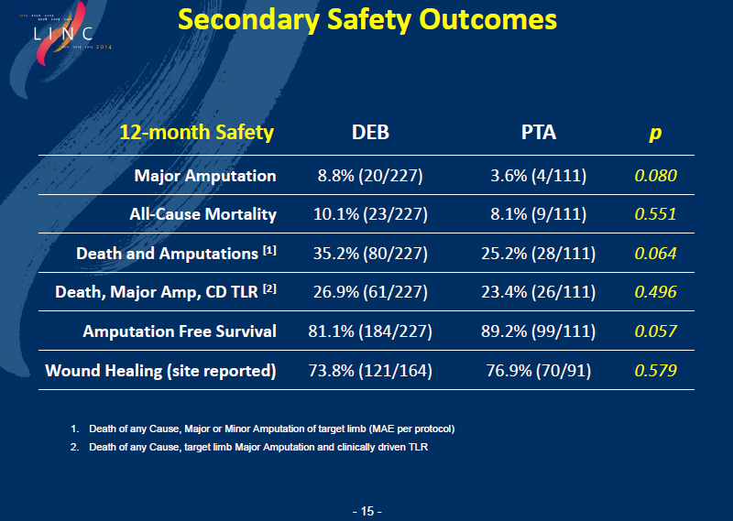
IN.PACT DEEP (FreePAC tech.)

Slide 22
In.Pact Deep: lack of a surveillance program
LEIPZIG Registry
“…multiple factors contribute to wound healing and limb salvage, including local wound care and surveillance regimen, which may be equally as important as revascularization. It therefore may be difficult to prove the superiority of the DEBs over uncoated balloons for these clinical endpoints…”
 | DCB (12-month) | PTA (15 month)
Deaths | 16.3% | 10.5%
Limb Salvage | 95.6% | 100%
Wound healing | 74.2% | 78.6%
Schmidt A et al. J Am Coll Cardiol. 2011 Sep 6;58(11):1105-9
Schmidt A et al. Catheter Cardiovasc Interv. 2010 Dec 1;76(7):1047-54
DEBATE BTK
“…once discharged, patients were followed in a multidisciplinary, dedicated foot clinic to facilitate healing process and recovery of the ambulatory function. Office visits were scheduled 2 days/week for the first 2 months, once a week for the third month and then every two weeks…”
12-month Outcomes | DCB | PTA | p
Deaths | 7.7% | 4.5% | 0.4
Major Amputation | 0% | 1.5% | 0.9
Wound healing | 86% | 67% | 0.01
Liistro F et al. Circulation. 2013 Aug 6;128(6):615-21
Notes:
100% limb salvage in DEBATE BTK may depend on several factors: 1) patients were enrolled only after successful wiring of the target vessel, therefore, the rate of major amputation observed cannot be compared to that derived from studies designed on an intention-to-treat basis; 2) presence of a dedicated multidisciplinary team providing wound care and continuous surveillance regimen of the foot lesion and vessel patency, including fast-track angiography and re-intervention when clinically needed. Office visits by a dedicated foot clinic team were scheduled 2 days/week for the first 2 months, once a week for the third month and then every two weeks

Slide 23
BTK-DCB: technical considerations
Really DIFFUSE disease (drug uptake)
Balloon insertion/navigation-consider a high drug loss
Predilatation
Geographical mismatch
Lower success ankle/foot lesions
BTK angioplasty: multidisciplinary team

Slide 24

Peripheral DCB: health/economic evaluation
Every 4 lesions treated (POBA/DCB)
1 TLR/24-mo AVOIDED with DCB
US: $ 2870
saved
Germany: E 662
saved
US: $ 250.000.000
SAVED/y.
Germany: E 30.500.000
SAVED/y.

Slide 25
Document key messages
Not all DCBs are created equal, even for the peripheral district.
Same tech considerations: predilatation, dissections.
Avoid stents if not strictly necessary.
BTK: RCT with newer gen. balloons, surveillance.

Slide 26
The new consensus document on peripheral DCB PTA
B. Cortese, J Granada, B Scheller, PA Schneider, G Tepe, D Scheinert, L Garcia, E Stabile, F Alfonso, G Ansel, T Zeller
Bernardo Cortese
Intv’ Cardiology, A.O. Fatebenefratelli
bcortese@gmail.com
bernardocortese.com

